Slide 1
My Shape and Angles
Interactive Notebook
Name
Class
Term 3 Semester 2

Slide 2
Contents
Formula Page
Page
Date
Description
2
3

Slide 3
Tasks
24
7
30
Essential Question
Questions
Notes
Summary
10
11

Slide 4
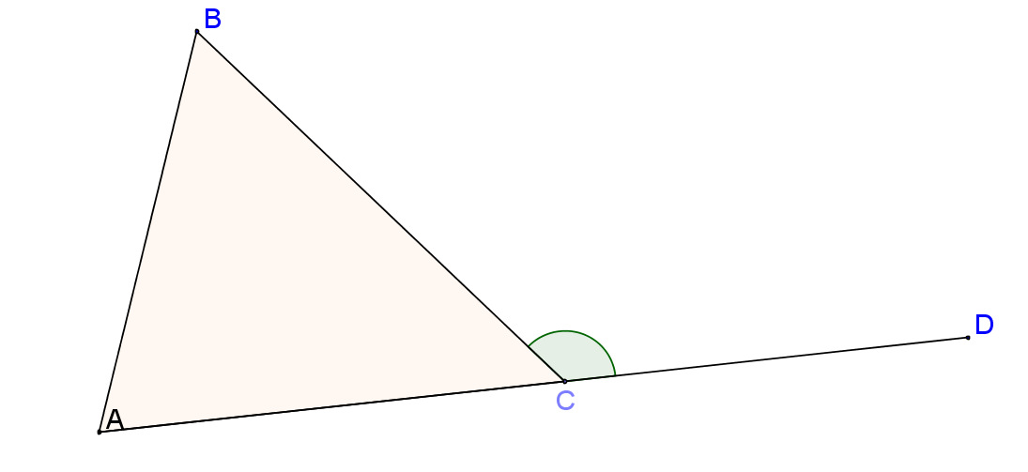
24
7
30
Date
Exterior angles in triangles
How is the exterior angle theorem used to calculate angles in triangles?
The exterior angle is the angle supplementary to the interior angle.
Exterior angle
11

Slide 5
Task 1
Sign on to connect
Maths class
Learning content
Angles
Exterior angles in a triangle

Slide 6
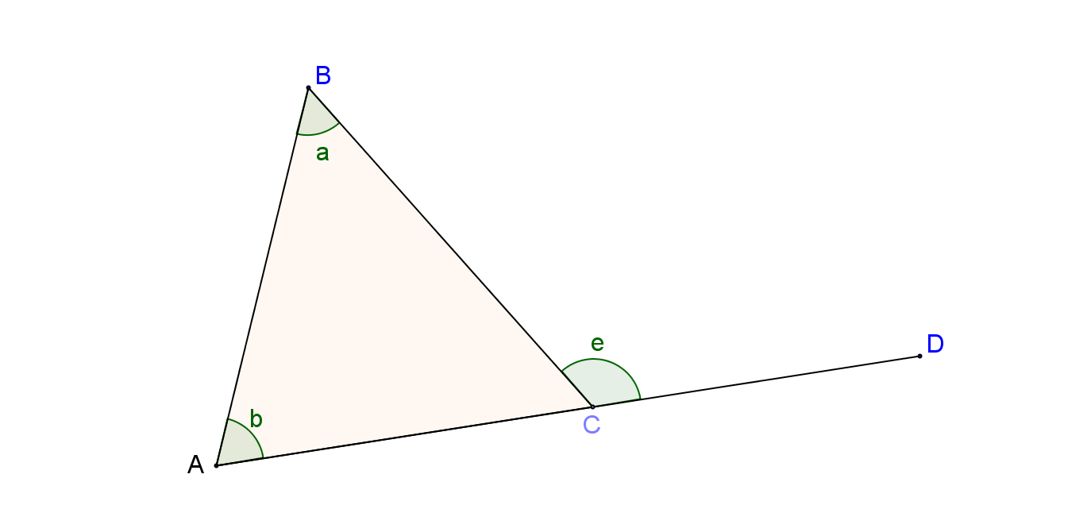
24
7
30
Date
Exterior angles
How is the exterior angle theorm used to calculate angles in triangles
Exterior angle Theorem - the exterior angle on a triangle is equal to the sum of the opposite interior angles.
e = a + b
11

Slide 7
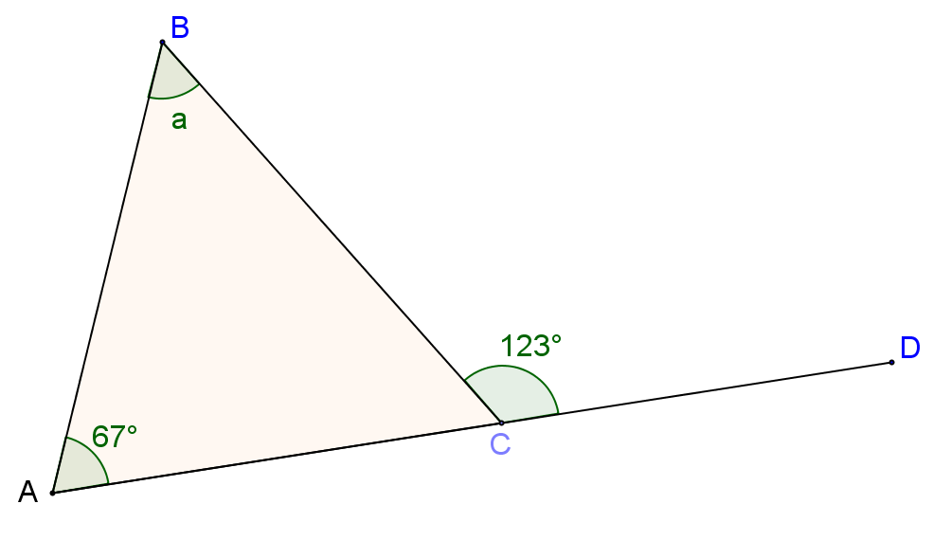
24
7
30
Date
Exterior angles
How is the exterior angle theorm used to calculate angles in triangles
Exterior angle Theorem - the exterior angle on a triangle is equal to the sum of the opposite interior angles.
e = a + b
E.g. Find a
11

Slide 8
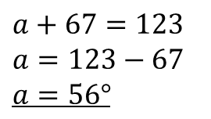
24
7
30
Date
Exterior angles
How is the exterior angle theorm used to calculate angles in triangles
Exterior angle Theorem - the exterior angle on a triangle is equal to the sum of the opposite interior angles.
e = a + b
E.g. Find a
$$a+67=123$$
$$a=123−67$$
$$a=56°$$
11

Slide 9
Fill in the questions

Slide 10
24
7
30
Date
Exterior angles
How is the exterior angle theorm used to calculate angles in triangles
What is an exterior angle?
The exterior angle is the angle supplementary to the interior angle.
Exterior angle
11

Slide 11
24
7
30
Date
Exterior angles
How is the exterior angle theorm used to calculate angles in triangles
Exterior angle Theorem - the exterior angle on a triangle is equal to the sum of the opposite interior angles.
What is the exterior angle theorem?
e = a + b
Example
E.g. Find a
$$a+67=123$$
$$a=123−67$$
$$a=56°$$
11

Slide 12
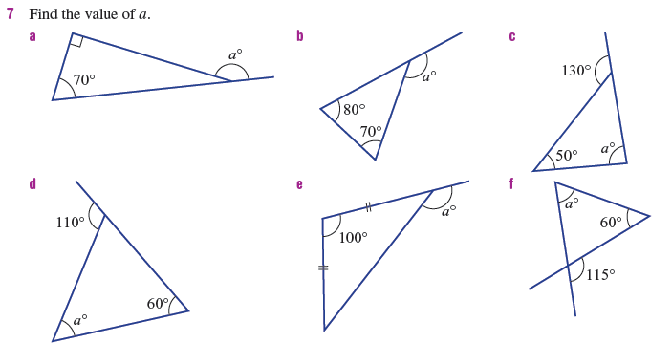

Slide 13
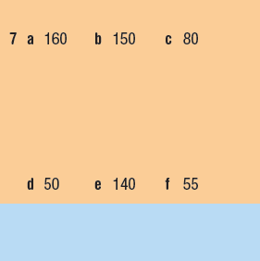
Answers

Slide 14
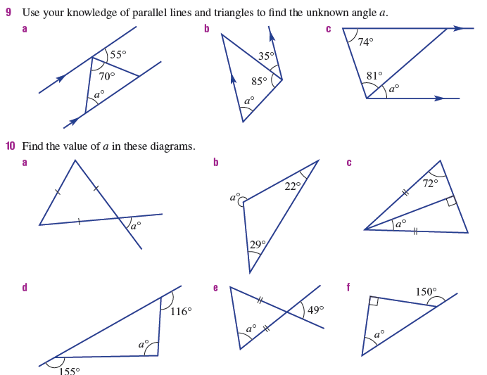

Slide 15
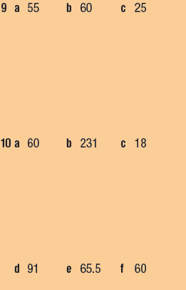
Answers

Slide 16
Notes Review
24, 7 ,30
Date
Title
Essential question
Notes complete
Notes complete with colour and diagrams
Questions completed
Contents page filed in
Formula page filled in

Slide 17
Homework
Review your notes and write a summary answering the essential question.

